Slide 1
Share a file

Slide 2
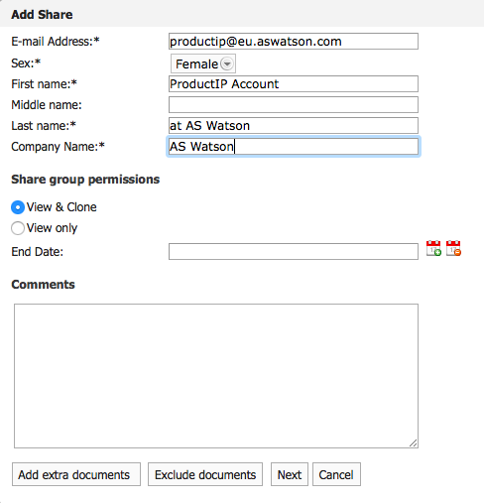
Open the file you want to share
Go to sharing tab
Choose “add share”
Use this information
Email adres:
productip@eu.aswatson.com
5. Select View & clone
You can exclude documents from sharing
6. Klik Next

Slide 3
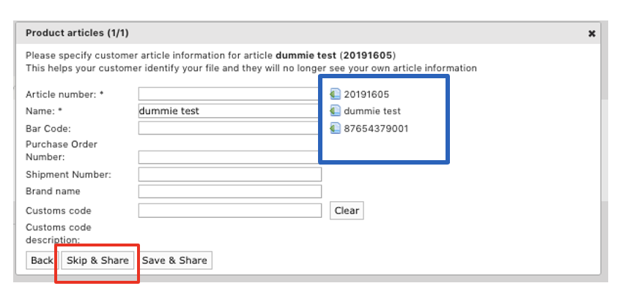
The barcode MUST always be shared
the information in the blue box, is the information being shared, if this is correct click Skip & Share. If this is not correct, you can enter the correct information for each article here. If you added the information use Save & Share

Slide 4

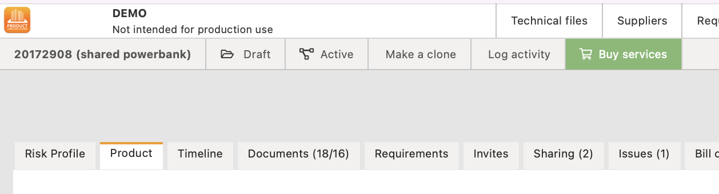
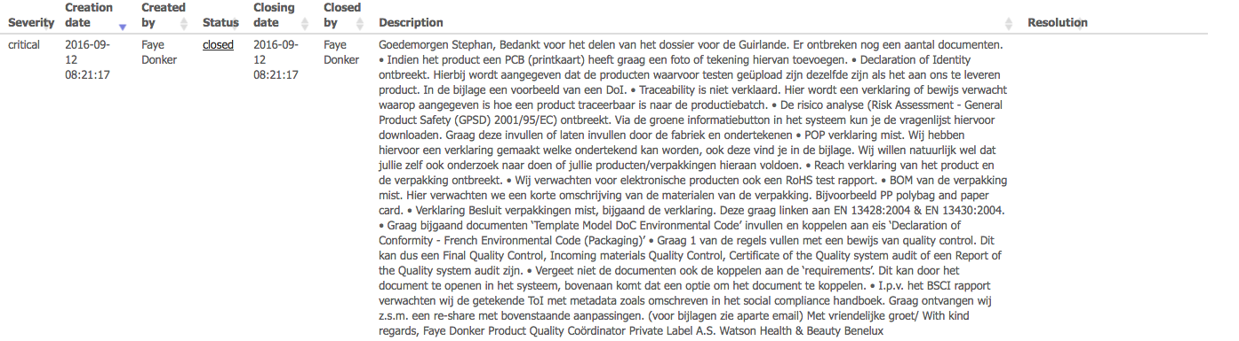
THE FILE IS DECLINED:
If a file is not accepted, the person
who shared it receives an email.
In the account, under Sharing, you can find all shares and their status.
Click on the product name to open the file.
Look at the tab review what the
comments are.

Slide 5
Adjust the file
Reshare the file by clicking on the
envelope.
If the status is pending and the file is modified, the modification is
also visible to the recipient.
It is not necessary to share again.
If the file is declined, you have to share the file again by clicking on the envelope.

Slide 6
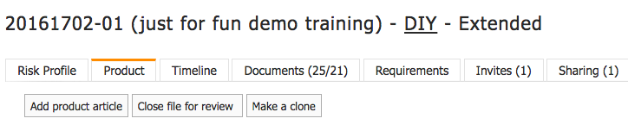
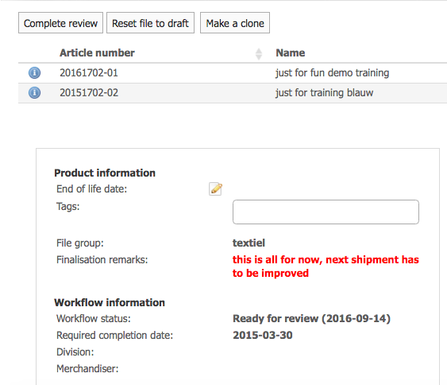
Close the file:

